Slide 1
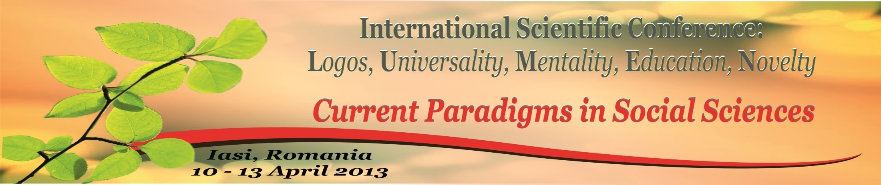
Social Semiotics: Unaccomplished Project
Helping Hand of Communication Theory

Slide 2
Semiotics is altogether social, same as philosophy itself. So why questioning?
We have to speak about two senses of the word “social” concerning semiotics; in a broader sense, it is a non-natural science; in a narrow and strict sense, what makes it social, is pragmatics…
…which is the 3rd part of semiotics.

Slide 3
Three Parts of Semiotics
According to Ferdinand de Saussure, Semiotics consists of three main parts:
Syntactics – which is a study of relationships between signs in a system;
Semantics – which is a study of relationships between signs and their meanings;
Pragmatics – which is a study of relationships between the realm of signs and human world.

Slide 4
Three Branches of Semiotics
Another important triplet:
Technical semiotics (computers and the like); it coincides with syntactics, mainly.
Linguosemiotics, having much in common with semantics.
Semiotics of socio-cultural forms (including art and literature, architecture and ship-building, finance and socio-political life, etc.) – which belongs to pragmatics.

Slide 5
Main problem of syntactics
The rules of selecting and combining signs into a code, or a system (organizational principles) is the main problem of technical semiotics, and thus of syntactics.
Analytical philosophy helped semiotics to formulate it as follows: “seeking for propositional functions of different grades”.
But more often than not this problem cannot obtain only formal solution; even the experience of logical positivism showed that syntax can only exist in a “double bind” with semantics.
(The expression comes from Deborah Tannen’s communication theory, 1987)

Slide 6
Main problem of semantics
Semantics is all about sense and meaning – and their vehicles, the signs.
There is a great number of semantic theories, or theories of meaning.
Nevertheless, they can be grouped somehow, on different grounds: e.g.:
“de jure” (epistemology, philosophy of science) and “de facto” (theory of knowledge, “correspondence” type);
“essential” and relativistic;
“substantial” and functionalistic, etc.
I argue that it is more fruitful to collect all the main theories into a circle – analogous to the circle of fifths in “Well Tempered Clavier” by J.S. Bach.

Slide 7
Main problem of pragmatics
There is none. At least it is not distinguished, yet.
Or else: all problems of pragmatics are equal.
Or else: all problems of pragmatics are equally important…
I argue that the most important of them is communication.

Slide 8
Controversy of Semantics and Pragmatics
Semantics is clearly logical, of high abstract level and theoretical value, its forming and limiting category is essence. Its quest is Cognition.
Pragmatics is vivid and “palpable”, rich and interesting, though not so highly abstract; its leading category is content and its quest is Communication.

Slide 9
In mathematic terms, we can view cognitive situation as a cycloid, and a communicative situation as its evolute.
The evolute [L₁] of the cycloid [L] is a cycloid, congruent with the original one but shifted for half length of the base and dropped under it at a distance equal to the height.

Slide 10
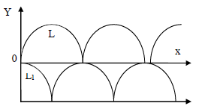
Cognition and Communication

Slide 11
Cognitive zero – when a human agent gets nothing really informative out of the conversation (objectively new information is absent) – coincides with the highest communicative value on the “y” axes (the subjects are included at most in exchange of the information available). Objectively, the newness, or novelty, is absent; BUT subjectively there is newness of small-talk kind, where the inter-subjectivity stands for objectivity.
On the contrary, the highest mind tension in zenith, bringing a discovery, a something absolutely new, is far above communication.
Such mental ecstasy is mute: it is a “Himmelmann” out of communication. No message is sent or gain; no conversation possible; it’s between me – and the Universe… (On the other pole, communication zero in nadir of [L₁] is just zero. No communication – no person – no society).

Slide 12
Main Obstacles on the Way of Accomplishing Semiotics
There is no part of Semiotics treating the relationship between signs – and objective reality.
We can think about Syntactics and Semantics as two sides of one medal; BUT:
Controversy of Semantics and Pragmatics is a gap with no bridge over it.
The difference lies within both subject and method.

Slide 13
Two Ways of Accomplishing Semiotics
We may try to construct the FOURTH part of semiotics, dealing with sign – objective world relationship ( and call it “sigmatics”). BUT:
It will have to concur with 15 000 other sciences existing, since all of them deal with the same.
We may try instead to make semiotics more “homogeneous” by REDUCING the number of parts.
For that we have to combine two first parts into one and preserve only semantics and pragmatics. BUT they are too different…

Slide 14
Helping Hand of Communication Theory
Semiotics becomes social when it gains social meaning.
We need a certain instrument, a switch-code from semantics to pragmatics and vice-versa.
Communication theory of Deborah Tannen (USA) provides for that.
She argues that social meaning does not reside in the dictionaries (semantics). It resides in a “double bind” of communication.

Slide 15
Double Bind and Adjustment
Involvement:
the familiar
safety
closeness
the need to be connected to the others
Independence:
the strange
freedom
distance
the need to be left alone…

Slide 16
Double Bind of Message and Metamessage
The core of Meaning of words and expressions is conceptual=cognitive information (message)
The subtle belt around it is weaved of emotions-volitions-preferences-selections…
The third component of Meaning does not reveal itself; it is a “cryptocomponent”; and this is where the metamessage comes in.

Slide 17
How we speak – “how loud, how fast, with what intonation and emphasis – communicates… teasing, flirting, explaining, or chastising; whether we are feeling friendly, angry or quizzical; whether want to get closer or back off… how we say what we say communicates social meaning”. (D. Tannen. That’s not what I meant! How Conversational Style Makes or Breaks Relationships. N.Y.1987, p. 16).
“Conversational style isn’t something extra, added on like frosting on a cake. It’s the very stuff of which the communication cake is made”. (D. Tannen, 1987, p. 33).
And here come main conversational devices creating sociality; these are expressive reaction, asking questions, complaining, and apologizing.

Slide 18
Conclusion
Combination of four main conversational devices provides for the needed mechanism of turning from sign-to-sign relations (syntactics) and/or sign-to-meaning relations (semantics) to the truly social world of pragmatics.
This is a necessary and sufficient switch-code turning from “pure” cognition to communication;
And in communication itself – to balance informative messages and metamessages of involvement and independence, the double social bind and “the deepest drive we have”.

